Slide 1
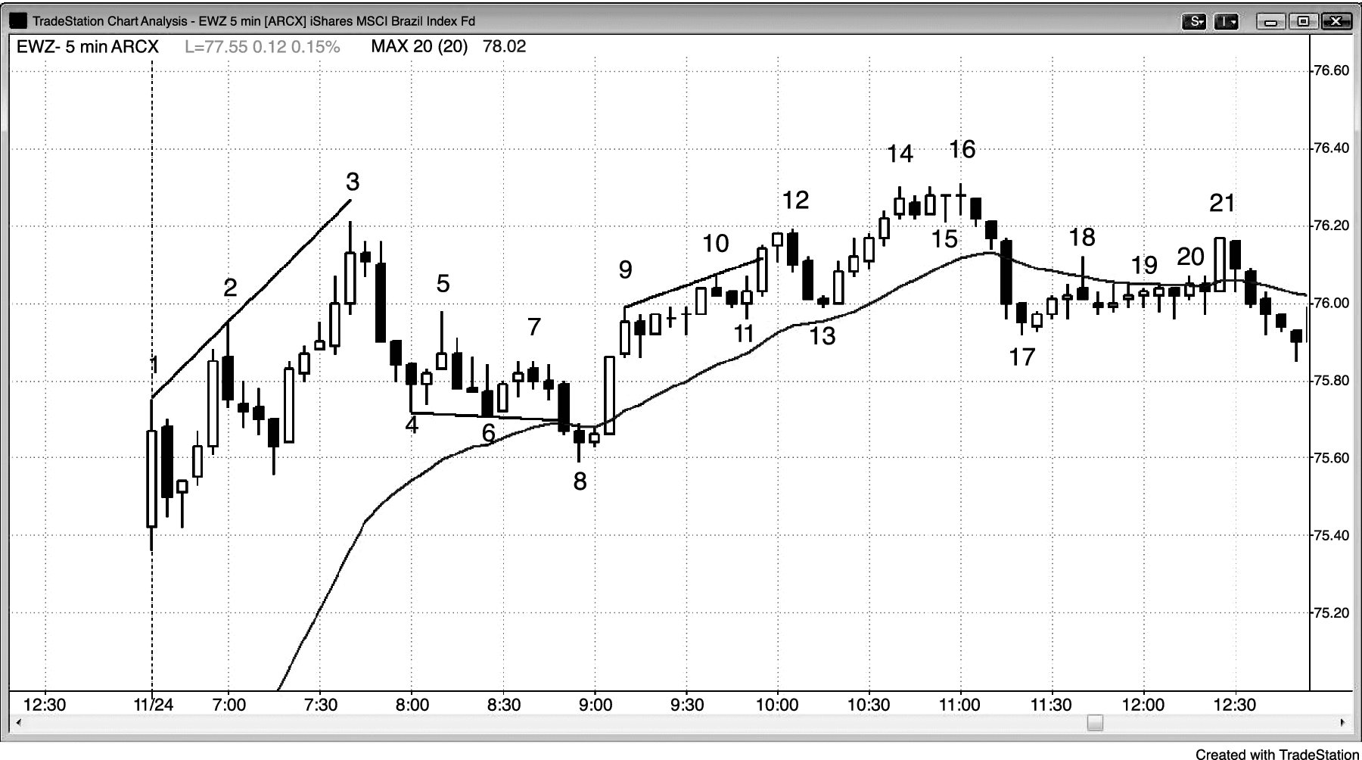
FIGURE 12.1 Setups Can Evolve into More Complex Patterns

Slide 2
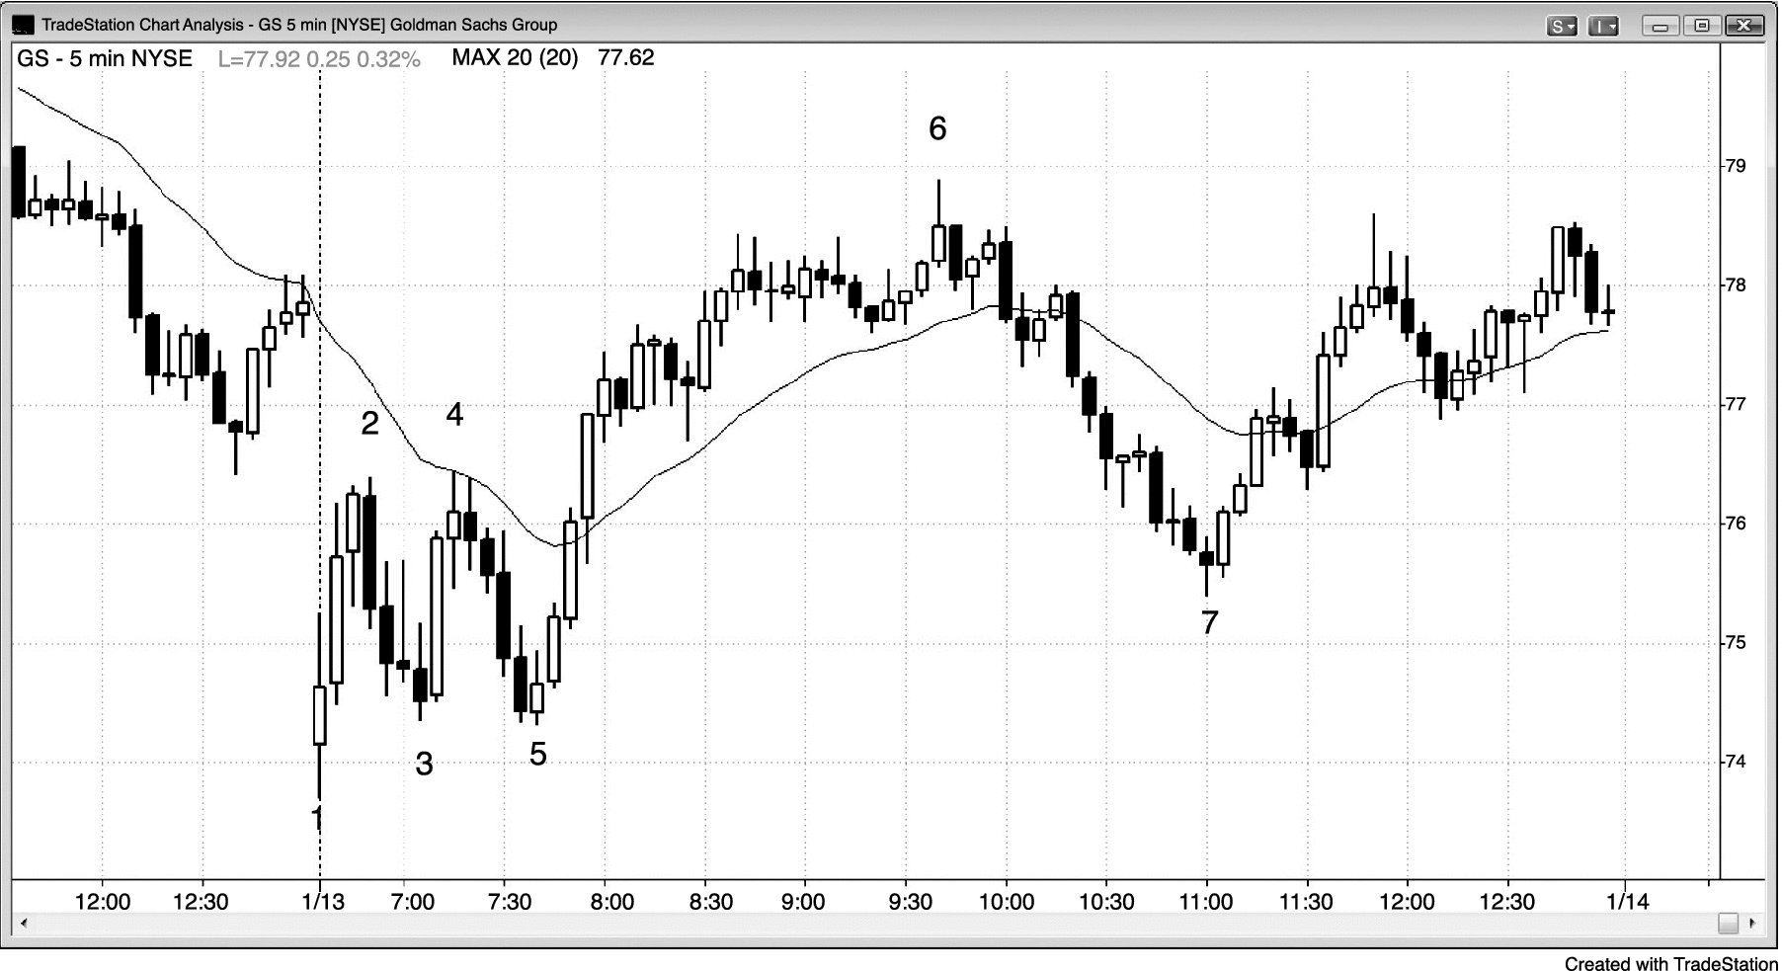
FIGURE 12.2 Breakout Mode in the First Hour

